Slide 1

VIDEO GAME SALES PROJECT ANALYSIS
ADEGBITE OLARONKE TEMITOPE ENTRY LEVEL, 2022

Slide 2
Introduction
Report on the analysis of Video Game Sales Performance Data from 1980-2020.
Aim: Analysing sales report to understand the performance of several video games and also, to identify opportunities for improving revenues
Several video games were utilized and their performances were analyzed based on the following;
Revenue
Genre (genre of the game)
Platform (platform of the game release)
Publisher (publisher of the game)
Year (year of the game’s release)
The report takes the following approach;
Data Cleaning with Excel and Tableau
Data Analysis for Insights
Data Visualization with Tableau
The key findings will be discussed in subsequent slides.

Slide 3
Data Design

Slide 4
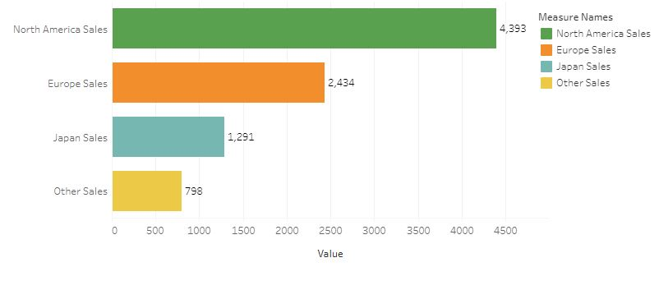
ANALYSIS SUMMARY
North American recorded the highest sales with a 49.27% contribution.
The highest sales occurred between 2008 to 2010
More games were released between 2008 and 2010
The top performing game was Wii Sports having its highest sales in North America
Top publisher and platform are “Nintendo” and “PS2 respectively.

Slide 5
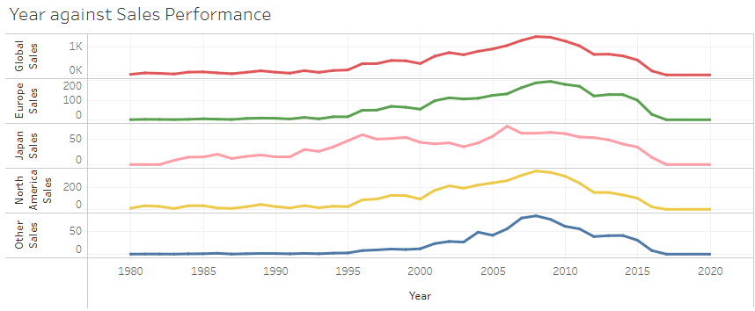
GLOBAL SALES ANALYSIS
KEY OBSERVATIONS
Highest sales were recorded between 2008 to 2010
After which sales began to drop through 2010. Why?

Slide 6
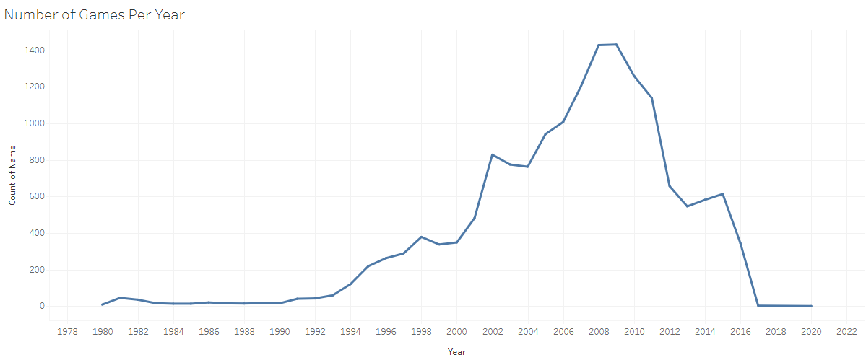
GLOBAL SALES ANALYSIS
KEY OBSERVATIONS
It was observed that more games were released between 2008 to 2010 after which it began to drop
The increase in number of games released between 2008 to 2010 was responsible for high sales experienced in those periods

Slide 7
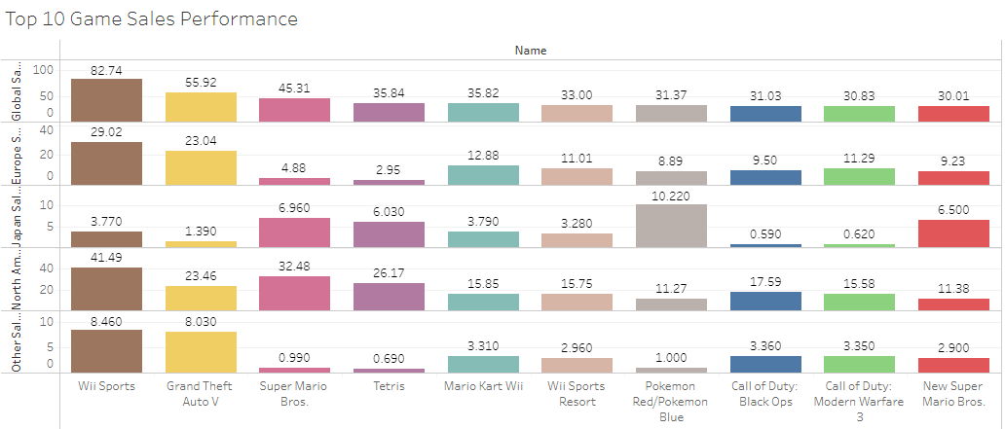
GAMES Breakdown Analysis
The highest performing game was “Wii Sports” having its highest sales record in North America. This explains why North America was the highest sold location.

Slide 8
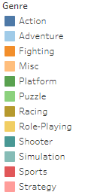
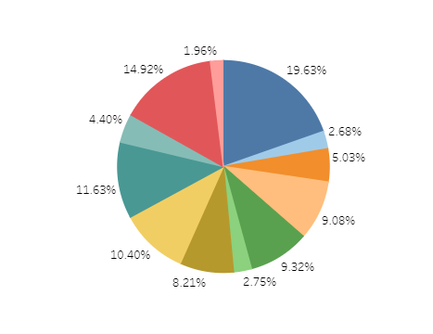
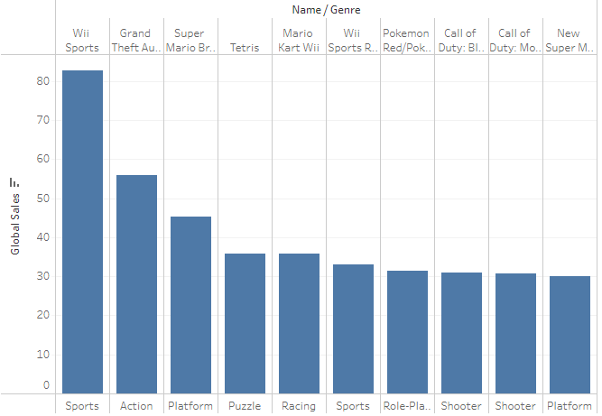
GENRE ANALYSIS
KEY OBSERVATIONS
The top three Genres were “Action”, ”Sports”, and “Shooter” with a contribution of 19.63%, 14.92% and 11.63% respectively. This shows that the genre of most games for the period under review was “Action”.
Looking at the top 10 performing games, we can see that the genre of the top performing game (Wii Sports) was “Sports”.

Slide 9

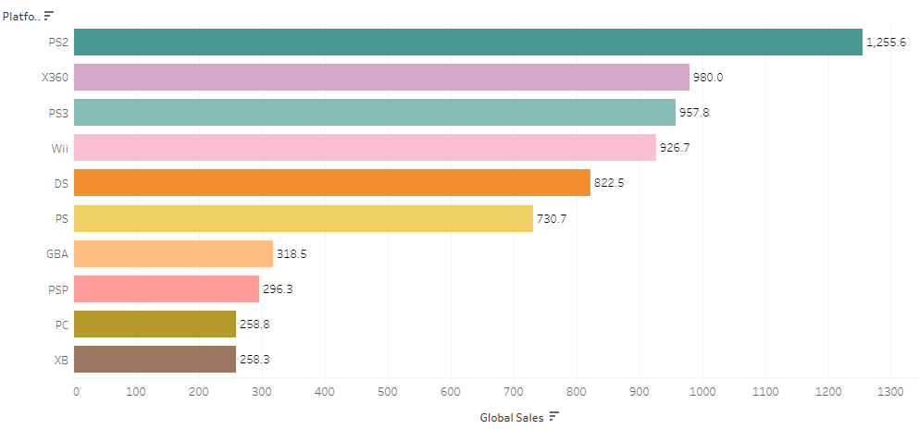
PLATFORM PERFORMANCE ANALYSIS
There were various platforms employed in the release of games.
“PS2” was the highest performing platform followed by “X360” and “PS3”

Slide 10
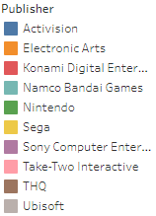
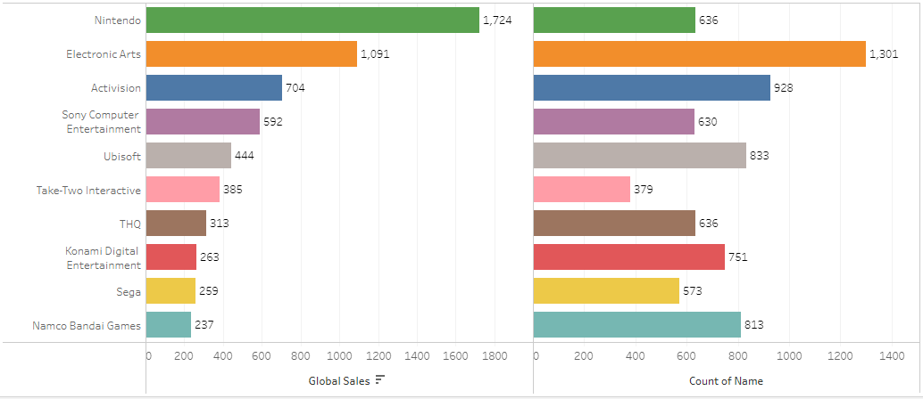
PUBLISHER ANALYSIS
In terms of publishers performance, “Nintendo” recorded the highest sales with a total sale of 1,724 followed by “Electronic Arts” and “Activision”.
However, in looking at the count of games circulated by each publisher, for the period under review, we can see that count of games released by each publisher is not a function of sales. We might as well say the users already have preference for the game publishers they patronize.

Slide 11
Conclusions And Recommendations
Conclusion
Wii Sports games were the best performing games, driving more revenue generation.
People are not interested in “strategy” and “puzzle” genres of game.
In general, sales improved drastically between 2008 and 2010 and dropped afterwards.
For game publishers, the number of games published is not a function of sales.
Recommendation
More sport related genre of games should be produced.
“Strategy” and “Puzzle” should be discontinued as a genre of game.
More games should be published by “Nintendo”
“Namco Bandal games” and “Konami Digital Entertainment” should be discontinued from publishing games.
Generally, more games should be introduced in order to improve sales performance globally.

Slide 12
THANK YOU

